Slide 1
Tutorial MBBS Batch 2016
22/05/2020
Specimen: Hydatidiform mole
Cases study on contraception & identification of the chosen method
Instruments: sponge-holder,towel clip

Slide 2

Specimen of Hydatidiform mole: Complete mole
Q.1 Why do you think it is a hydatidiform mole?
Q.2 Why do you call it a complete mole?
Notes:
Other names of hydatidiform mole?
What group of conditions is it included in?

Slide 3
Typical case presentation
A 24 year woman with one living child before presented with hyperemesis gravidarum and bleeding pv. The uterus was larger than expected fo her dates and she passed the tissue shown.

Slide 4
Questions
What will be the ultrasound appearance in this case?
Snowstorm appearance
What hormonal test will you ask for immediately?
Serum beta HCG levels

Slide 5
What is the chromosomal pattern in this type of mole?
46 XX- both of paternal origin
Is it a benign or malignant condition?
Benign with malignant potential

Slide 6
How do you manage this case?
Admit at once
Investigations
Arrange blood
Evacuation of uterus as soon as possible
Immediate post-operative management
Advice at discharge
Follow-up protocol

Slide 7
How do you evacuate this uterus ?
In O.T.
Anesthesia
Cervical softening
Cervical dilatation
Suction evacuation( electric/ manual)

Slide 8
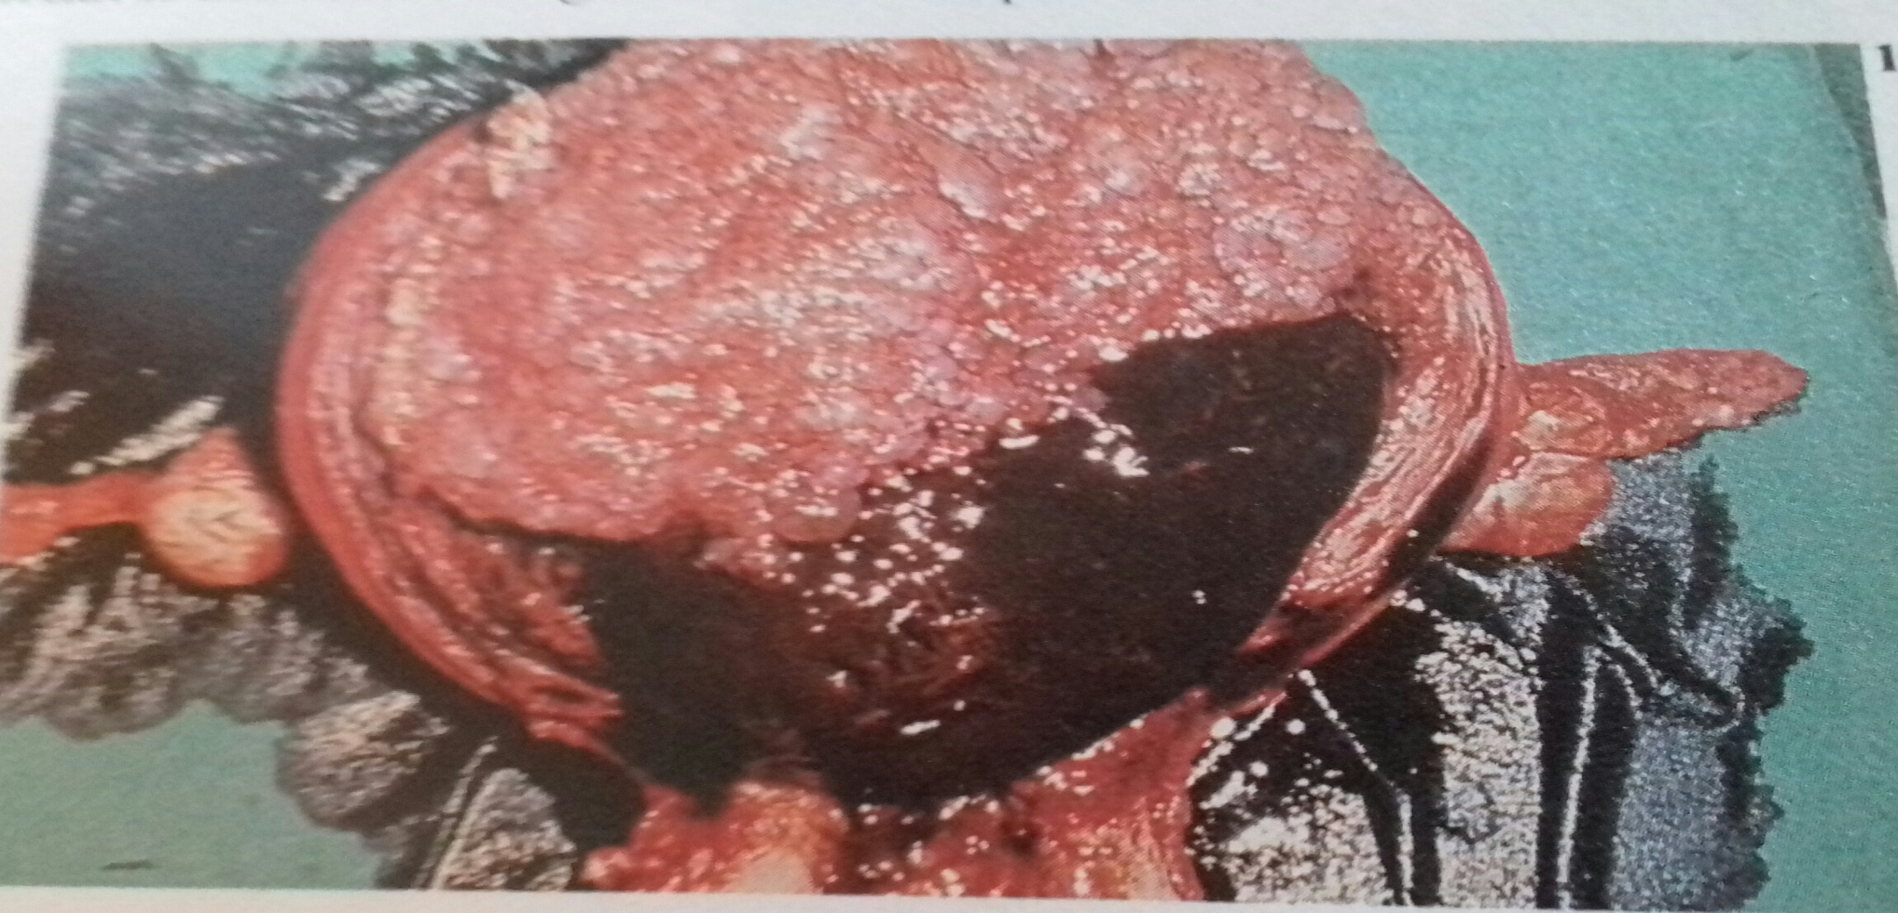
Total abdominal hysterectomy with bilateral salpingo-oophorectomy
What do you think is the problem for which the woman came for advice?

Slide 9
Contraception Case 1
A newly married couple from Muzaffarpur comes for contraceptive advice to postpone pregnancy for 2 years. The husband is working in a private company in Delhi and will take his wife there after one year when he gets a separate accomodation. Meanwhile he comes for a week during Holi and Chaat festivals. They want a pregnancy only when he gets promotion after 2 years.

Slide 10
Questions
What important information is missing?
Why?
What contraception should the couple use for one year now?
Why?
What will you tell them about the method?

Slide 11
Sudipt Anand’s answers
- Age of wife
-Age of patient helps in selection of appropriate type of contraceptive method.
-Barrier method
-Because it's safe, cheap, convenient to use, it has least side effects and it doesn't alter the fertility of individuals.
-It's method of use, side effects and failiure rate.
Anish’s answers
Age of wife.
*Age of patient helps in selection of appropriate type of contraceptive method. like young patients are not suitable for sterilization and lactating patients are not preferred for COCs .
*Barrier method .
*Because it's safe cheap convenient to use has least side effects and it does not affect the fertility of couple .
*It's method of use failure rate side effects.

Slide 12
Answers
What important information is missing?
Age of wife
Why?
It is important for counseling of the couple about how long they should postpone the pregnancy because after 30 yrs and especially after 35 yrs ovarian function deteriorates and medical disorders may arise thus compromising pregnancy outcome
Age of patient helps in selection of appropriate type of contraceptive method e.g. young patients are not suitable for sterilization and lactating patients are not preferred for COCs .

Slide 13
Answers
What contraception should the couple use for one year now?
Barrier contraception
Why?
Fairly high success rate (15 pregnancy/HWYs)
Needs to be used only at time on sexual intercourse,
Minimal systemic adverse effects
Safe cheap convenient to use
It does not affect the fertility of couple .
Note: requires motivation and education of husband on its use
What will you tell them about the method?
Method of use; success/failure rate; additional benefits(!! Protection from STIs)

Slide 14
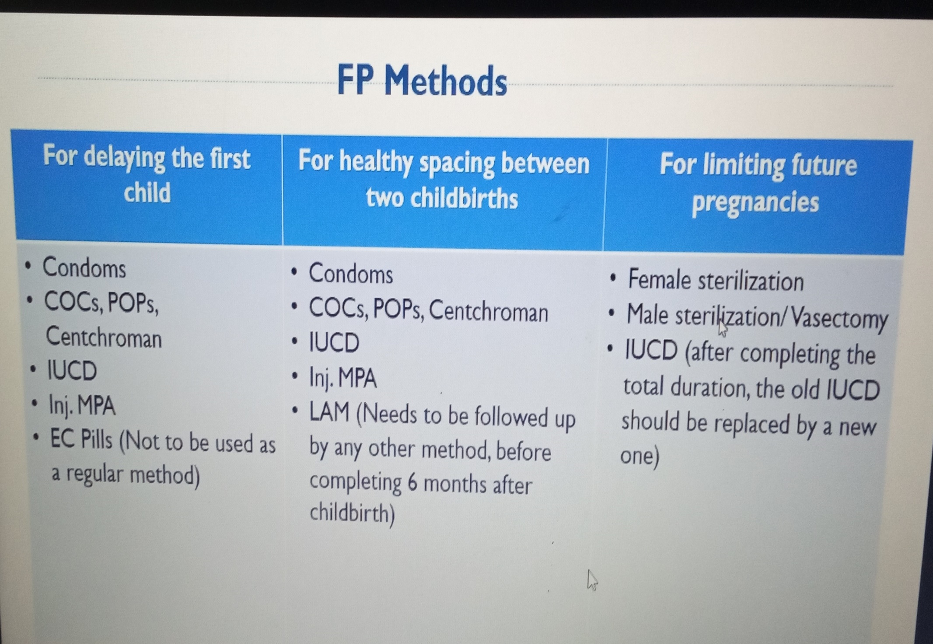

Slide 15
Case 2
A 26 yr old rural woman with one living 2 yr child attends FP clinic for CuT insertion since her ASHA has told her it is very convenient. She lives with her husband next to the PHC, has irregular heavy periods, looks very pale and Hb% is 7.5g%

Slide 16
Questions
Do you think her choice is appropriate? Why?
What other methods can she use?

Slide 17
Sudipt Anand’s answers
-No
-As she is anemic and has irregular heavy periods, inserting IUD will only worsen her health conditions by makeing her bleed more heavily and she will require additional medication to remain healthy.
-OCPs, condoms, Injectables
Anish’s answers
*No
*As she has irregular heavy periods and she is anemic , inserting IUD will only make her condition worsen and she may require additional medication to remain healthy .
*OCPs condoms injectable .

Slide 18
Do you think her choice is appropriate? Why?
No
She is pale, Hb% is only 7.5gm% and has heavy irregular periods. CuT will aggravate her menorrhagia and make her anemia worse
What other methods can she use?
OCPs, Inj. Antara, Barrier methods(condoms)

Slide 19
Questions
Woman admits she forgets to take tablets
Do you think this information is useful to you?
Why?
If she was in a developed country what other method could she use? How long?

Slide 20
Sudipt Anand’s answers
Yes this information is useful as it tells that patient is forgetful she may miss her pills so OCPs shouldn't be prescribed to her.
-If she was in developed country she can use skin patches, LNG IUS. She can use these methods till the time she wanted to avoid pregnancies.
Anish’s answers
Yes, this information by is useful.
This information helps to decide that OCPs can't be prescribed to her as she may miss it .
If she was in developed country she can use skin patches , implants .she can use these methods

Slide 21
Woman admits she forgets to take tablets
Do you think this information is useful to you? Why?
Yes; she is very likely to miss tablets in the pack which will cause menstrual irregularity and increase chances of failure rate
If she was in a developed country what other method could she use? How long?
Progestogen containing Intra-uterine System (market names-Mirena, Emirelle;
Can use it upto 5 years

Slide 22
Case 1 & 2 are examples of Interval contraception

Slide 23
Case 3
A 32 yr old para 1 who delivered 4weeks ago wants contraception

Slide 24
What other hx is specifically important in this case ?
Which method have an effect on breast feeding ?

Slide 25
Reshu’s answers
What other hx is specifically important in this case ?
Ans.- Obstetric Hx •
Which method have an effect on breast feeding ?
Ans - OCPs •
Avinash’s answers
What other hx is specifically important in this case ?
History and general should be through taking special care for contraindications (headache, migraine)
- examination of breast for any nodule, wt., b.p are noticed.
- pelvic examination to exclude cervical pathology in mandatory. - cervical cytology to exclude abnormal cell.
-for selection of contraceptive method amd minimize the adverse effect of contraceptive and improve life of patient.
Which method have an effect on breast feeding ?
combined oral contraceptive reduce the milk secretion and also quality.
If she does not want to use another method how long can she use her current method ?
Ans- She can use barrier methods , Injectables .
Duration of effect of injectables is 3 months.

Slide 26
What other hx is specifically important in this case?
Hx of breast feeding or not- enquire if she is breast feeding exclusively
How long does she want to postpone next pregnancy
Coital frequency
Why?
Chosen method should not interfere with lactation if she is breast feeding exclusively
Should be tailored to her needs re. how long she wants to postpone pregnancy and her chances of getting pregnant in each cycle e.g. if she lives with her husband IUCD or injectable will be suitable but if he comes occasionally then condoms may be sufficient.
Which method can have an effect on breast-feeding?
Combined Oral contraceptive pills

Slide 27
Pt. says she has heard breast feeding will prevent pregnancy.
How will you counsel her?
If she does not want to use another method how long can she safely use her current method?

Slide 28
Reshu’s answers
Ans-Breast feeding may work as a form of birth by delaying the return of her period. However , it only work if her breast feeding is frequent and regular . In particular breast feeding as contraceptive only work if ;
▪ Baby is younger than 6 months
▪ Her period have not return
Once her baby stops breastfeeding , this method is not effective Contraception and she need to use another form of contraception .
Ans- She can use barrier methods , Injectables . Duration of effect of injectables is 3 months.
If she does not want to use another method how long can she use her current method ?
Answer not given clearly
.

Slide 29
Avinash’s answers
Ans-Breast feeding may work as a form of birth by delaying the return of her period .However , it only work if her breast feeding is frequent and regular . In particular breast feeding as contraceptive only work if ; ▪ Baby is younger than 6 months ▪ Her period have not return
Once her baby stops breastfeeding , this method is not effective Contraception and she need to use another form of contraception .
Ans- She can use barrier methods , Injectables . Duration of effect of injectables is 3 months.
Progestin only pill no adverse effect on lactation, hence can be suitably prescribed in lactating women and is also called lactating pill
Inj DMPA and NET EN can safely use during lactation.
in fully lactating women(5-6 feed and spending about 60 minute in 24 hrs) the contraceptive pratice may be safely withheld for 10 week postpartum, pill is better withheld.
Progestin only pill(minipill) or injectable steroid is ideal

Slide 30
Discussion on LAM
3 criteria
Exclusive breast feeding
Only for 6 months
No menstruation
Success rate close to OCPs, IUCDs combined
with all other benefits to mother and baby

Slide 31
Case 4
A newly married couple comes to you for advice on how to delay pregnancy for 5 years . The age of the wife is 30 years. They do not want to use condoms , IUCD or OCPs due to religious reasons.

Slide 32
Questions
What important issue should you explore and inform while talking to this woman ?
How can you help them choose the best methods ?

Slide 33
Reshu’s answers
What important issue should you explore and inform while talking to this woman ?
Ans- Proper Counselling should be given to the couple regarding myths , misconceptions they have related to contraception .
• How can you help them choose the best methods ?
Ans- Barrier method

Slide 34
Answers
Counselling is very important
Importance of not delaying pregnancy since she is going beyond 30 years
Convincing her that many women from all communities are accepting different types of contraception and birth-control methods are not the same as pregnancy termination.

Slide 35
How can you help them choose the best method?
Asking them about coital frequency,
Does she take medicines regularly,
Checking her medical hx for any contraindications
Past experience with contraception and whether she liked it or not

